Slide 1
STOR 455 Effects of a Categorical Variable and Polynomial Regression
Read: 3.4, 4.5
Exercises: 4.13, 15
3.23, 27, 29, 45

Slide 2
Example: Legos
Response Variable:
Y =Amazon Price
Predictors:
X₁ = Pieces
X₂ = Theme (Star Wars or Friends)

Slide 3
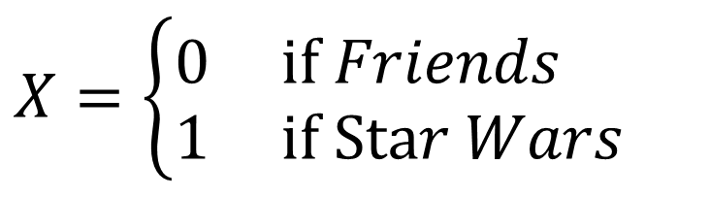
Coding “Dummy” Predictors
We can code a categorical predictor as (0,1)
How should this be interpreted in a regression?
Example: Y = Amazon Price
$$X=\left\{\begin{aligned}&0 \text{if} Friends \\ &1 \text{if} \text{Sta}r Wars\end{aligned}\right.$$

Slide 4
MTB output to compare two lines
Quantitative + Indicator +Interaction
modlegoint=lm(Amazon_Price ~ Pieces + Theme + Pieces*Theme, data=lego2)
summary(modlegoint)
Estimate Std. Error t value Pr(>|t|)
(Intercept) 9.06395 5.99060 1.513 0.132
Pieces 0.11233 0.01538 7.302 8.96e-12 ***
ThemeStar Wars -1.51114 7.60839 -0.199 0.843
Pieces:ThemeStar Wars 0.03532 0.01643 2.149 0.033 *
---
Residual standard error: 36.38 on 179 degrees of freedom
(39 observations deleted due to missingness)
Multiple R-squared: 0.8085, Adjusted R-squared: 0.8053
F-statistic: 252 on 3 and 179 DF, p-value: < 2.2e-16
$$\hat{Amazon_Price}=\text{9.06395}+\text{0.11233}Pieces\text{−1.51114}Theme+\text{0.03532}Pieces∗Theme$$
How does this relate to the two lines?
Substitute Theme=0 and Theme=1

Slide 5
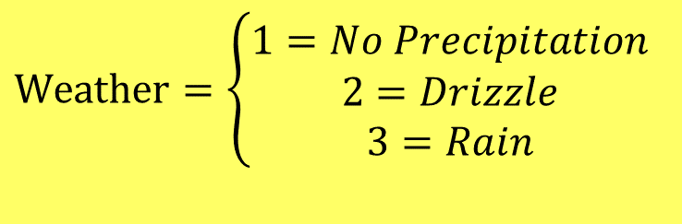
More than Two Categories
Example: Turtles
$$\text{Weather}=\left\{\begin{aligned}1=No Precipitation \\ 2=Drizzle \\ 3=Rain\end{aligned}\right.$$
Try a model to predict Y = Annuli using X = Weather.
How should the coefficients be interpreted?

Slide 6
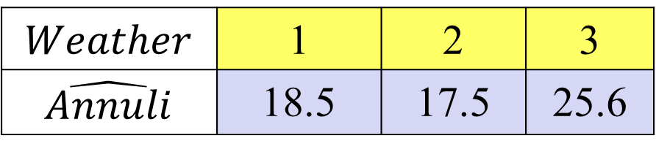
Predicting Annuli with Weather
Call:
lm(formula = Annuli ~ Weather, data = Turtles3)
Coefficients:
Estimate Std. Error t value Pr(>|t|)
(Intercept) 16.871 1.174 14.366 <2e-16 ***
Weather 1.570 1.023 1.535 0.126
---
Residual standard error: 5.926 on 275 degrees of freedom
Multiple R-squared: 0.008496, Adjusted R-squared: 0.00489
F-statistic: 2.356 on 1 and 275 DF, p-value: 0.1259
$$Weather$$ | 1 | 2 | 3
$$\hat{Annuli}$$ | 18.5 | 17.5 | 25.6

Slide 7
Dummy Indicators for Multiple Categories
For a categorical predictor with k levels, we use k-1 dummy indicators.
...
R Trick: (To create indicator variables)
Turtles3$NoPrecip=(Turtles3$Weather==1)*1
What happens to Group #k?
Be careful!

Slide 8

Predicting Annuli Using NoPrecip and Drizzle Weather Indicators
Call:
lm(formula = Annuli ~ NoPrecip + Drizzle, data = Turtles3)
Coefficients:
Estimate Std. Error t value Pr(>|t|)
(Intercept) 25.600 2.630 9.734 < 2e-16 ***
NoPrecip -7.080 2.655 -2.666 0.00812 **
Drizzle -8.100 3.013 -2.688 0.00762 **
---
Residual standard error: 5.881 on 274 degrees of freedom
Multiple R-squared: 0.02731, Adjusted R-squared: 0.02021
F-statistic: 3.846 on 2 and 274 DF, p-value: 0.02253
$$Weather$$ | 1 | 2 | 3
$$\hat{Annuli}$$ | 18.5 | 17.5 | 25.6

Slide 9
Dummy Indicators for Multiple Categories
For a categorical predictor with k levels, we use k-1 dummy indicators.
...
What happens to Group #k?
Reference group
Constant term is an estimate for Group #k and other coefficients are the differences from it.

Slide 10
Handling Categorical Predictors in R
If a predictor in lm( ) has “text” values, R will automatically create indicators for all but one category.
Using factor( )around a quantitative predictor in lm( )creates the indicators.
modelW3=lm(Annuli ~ factor(Weather), data = Turtles3)

Slide 11
Handling Categorical Predictors in R
modelW3=lm(Annuli~factor(Weather),data=Turtles3)
summary(modelW3)
Coefficients:
Estimate Std. Error t value Pr(>|t|)
(Intercept) 18.5195 0.3675 50.389 < 2e-16 ***
factor(Weather)2 -1.0195 1.5154 -0.673 0.50165
factor(Weather)3 7.0805 2.6554 2.666 0.00812 **

Slide 12
Multiple Categories in Regression
With indicator variables for categories we can include quantitative and categorical predictors in the same model
modelW4=lm(Annuli~Mass+factor(Weather),data=Turtles3)
summary(modelW4)
Coefficients:
Estimate Std. Error t value Pr(>|t|)
(Intercept) 11.946076 1.383680 8.634 5.03e-16 ***
Mass 0.019001 0.003867 4.913 1.55e-06 ***
factor(Weather)2 -0.937183 1.455274 -0.644 0.5201
factor(Weather)3 6.369064 2.554029 2.494 0.0132 *

Slide 13
Multiple Categories in Regression
With indicator variables for categories we can include quantitative and categorical predictors in the same model
modelW5=lm(log(Annuli)~log(Mass)+factor(Weather),data=Turtles3)
summary(modelW5)
Coefficients:
Estimate Std. Error t value Pr(>|t|)
(Intercept) 0.65953 0.31334 2.105 0.0362 *
log(Mass) 0.38165 0.05389 7.082 1.21e-11 ***
factor(Weather)2 -0.07868 0.07381 -1.066 0.2874
factor(Weather)3 0.22486 0.12948 1.737 0.0836

Slide 14
Multiple Categories in Regression with Interactions
With indicator variables for categories we can include quantitative, categorical, and interaction predictors in the same model
modelW5int=lm(log(Annuli)~ log(Mass) + factor(Weather) + log(Mass)*factor(Weather),data=Turtles3)
summary(modelW5int)
Coefficients:
Estimate Std. Error t value Pr(>|t|)
(Intercept) 0.91860 0.32740 2.806 0.00538 **
log(Mass) 0.33702 0.05632 5.984 6.86e-09 ***
factor(Weather)2 -2.16926 0.97815 -2.218 0.02740 *
factor(Weather)3 -21.63209 8.98096 -2.409 0.01668 *
log(Mass):factor(Weather)2 0.36295 0.16937 2.143 0.03301 *
log(Mass):factor(Weather)3 3.67719 1.51041 2.435 0.01556 *

Slide 15
Model Selection with Categorical and Interaction Predictors
Use each of the four model selection methods discussed in class (AllSubsets, Backwards, Forwards, and Stepwise) and compare the processes and outcomes for the predictor pool:
log(Mass), log(ShellHeightatHinge), Weather, log(Mass), & Weather, and log(ShellHeightatHinge), & Weather

Slide 16
Example: State SAT Scores
Source: Statistical Sleuth, Case 12.1 pg. 339
Response Variable:
SAT =Average combined SAT Score
Potential Predictors:
Takers = % taking the exam
Income = median family income ($100’s)
Years = avg. years of study (SS, NS, HU)
Public = % public school
Expend = spend per student ($100’s)
Rank = median class rank of takers

Slide 17
R: Best Subsets for StateSAT
library(leaps)
all=regsubsets(SAT~Takers+Income+Years+Public+Expend+Rank,
data=StateSAT,nbest=2)
ShowSubsets(all)
Takers Income Years Public Expend Rank Rsq adjRsq Cp
1 ( 1 ) * 77.42 76.95 34.03
1 ( 2 ) * 73.58 73.03 47.64
2 ( 1 ) * * 84.71 84.05 10.22
2 ( 2 ) * * 80.54 79.71 24.97
3 ( 1 ) * * * 87.11 86.27 3.69
3 ( 2 ) * * * 85.84 84.91 8.21
4 ( 1 ) * * * * 87.71 86.61 3.58
4 ( 2 ) * * * * 87.67 86.57 3.72
5 ( 1 ) * * * * * 87.87 86.49 5.00
5 ( 2 ) * * * * * 87.73 86.34 5.48
6 ( 1 ) * * * * * * 87.87 86.18 7.00
SATbestmod = lm(SAT~Years+Public+Expend+Rank, data=StateSAT)

Slide 18
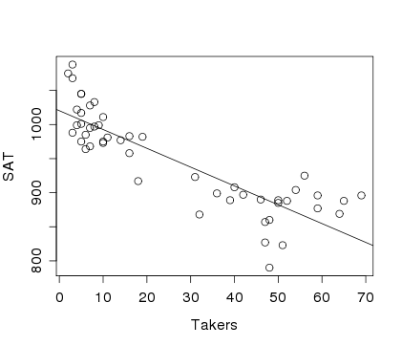
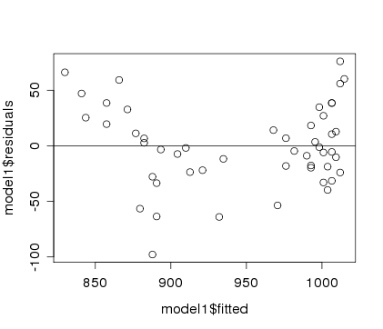
Example: State SAT
Model #1: Y=SAT vs. X=Takers
Would a “curved” line work better?
modSAT1=lm(SAT~Takers,data=StateSAT)
summary(modSAT1)
Estimate Std. Error t value Pr(>|t|)
(Intercept) 1020.3062 8.1391 125.36 < 2e-16 ***
Takers -2.7600 0.2387 -11.56 1.77e-15 ***
---
Residual standard error: 36.8 on 48 degrees of freedom
Multiple R-squared: 0.7358, Adjusted R-squared: 0.7303
F-statistic: 133.7 on 1 and 48 DF, p-value: 1.768e-15

Slide 19
Polynomial Regression
For a single predictor X:
(linear)
(quadratic)
(cubic)

Slide 20
Polynomial Regression in R
Method #1: Create new variables with predictor powers.
StateSAT$TakersSq=StateSAT$Takers^2
modSATquad1=lm(SAT~Takers+TakersSq,data=StateSAT)
To avoid creating a new variable…
Method #2: Use I( )in the lm( )
modSATquad2=lm(SAT~Takers+I(Takers^2),data=StateSAT)
Method #3: Use poly
modSATquad3=lm(SAT~poly(Takers,degree=2,raw=TRUE), data=StateSAT)

Slide 21
Quadratic model for SAT
modSATquad2 = lm(SAT~Takers+I(Takers^2),data=StateSAT)
summary(modSAT2I)
Coefficients:
Estimate Std. Error t value Pr(>|t|)
(Intercept) 1053.13112 9.27372 113.561 < 2e-16 ***
Takers -7.16159 0.89220 -8.027 2.32e-10 ***
I(Takers^2) 0.07102 0.01405 5.055 6.99e-06 ***
Residual standard error: 29.93 on 47 degrees of freedom
Multiple R-squared: 0.8289, Adjusted R-squared: 0.8216
F-statistic: 113.8 on 2 and 47 DF, p-value: < 2.2e-16
$$\hat{SAT}=1053.1−7.1616Takers+0.0710{Takers}^{2}$$

Slide 22
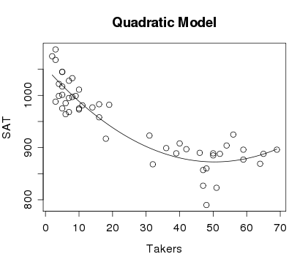
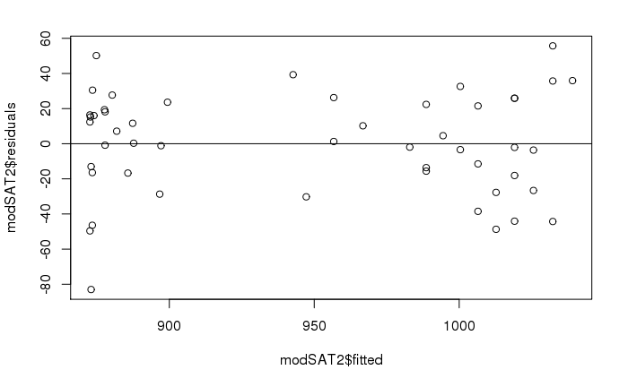
Quadratic model for SAT
plot(SAT~Takers,main="Quadratic Model",data=StateSAT)
B0_modSATquad2 = summary(modSATquad2)$coef[1,1]
B1_modSATquad2 = summary(modSATquad2)$coef[2,1]
B2_modSATquad2 = summary(modSATquad2)$coef[3,1]
curve(B0_modSATquad2 + B1_modSATquad2*x
+ B2_modSATquad2*x^2, add=TRUE)

Slide 23
Would a Cubic work better?
modSATcubic = lm(SAT~Takers+I(Takers^2)+I(Takers^3),data=StateSAT)
summary(modSATcubic)
Estimate Std. Error t value Pr(>|t|)
(Intercept) 1.051e+03 1.452e+01 72.366 < 2e-16 ***
Takers -6.753e+00 2.380e+00 -2.837 0.00676 **
I(Takers^2) 5.631e-02 8.051e-02 0.699 0.48777
I(Takers^3) 1.408e-04 7.586e-04 0.186 0.85353
---
Residual standard error: 30.24 on 46 degrees of freedom
Multiple R-squared: 0.829, Adjusted R-squared: 0.8178
F-statistic: 74.33 on 3 and 46 DF, p-value: < 2.2e-16
modSATquad2 = lm(SAT~Takers+I(Takers^2),data=StateSAT)
summary(modSATquad2)
Residual standard error: 29.93 on 47 degrees of freedom
Multiple R-squared: 0.8289, Adjusted R-squared: 0.8216
F-statistic: 113.8 on 2 and 47 DF, p-value: < 2.2e-16

Slide 24
Nested F-test
$$SAT =β_{0}+β1Takers+_{2}Takers2+ 3Takers3+ε$$
H₀: β₃=0
H_{a}: Some β₃≠0
anova(modSATquad2, modSATcubic)
Analysis of Variance Table
Model 1: SAT ~ poly(Takers, degree = 2, raw = TRUE)
Model 2: SAT ~ Takers + I(Takers^2) + I(Takers^3)
Res.Df RSS Df Sum of Sq F Pr(>F)
1 47 42101
2 46 42069 1 31.524 0.0345 0.8535

Slide 25
Second Order Models
Definition: A second order model for two quantitative predictors would be
first order
quadratic
interaction
second order
Example: Try a full second order model for
Y=SAT using X₁=Takers and X₂=Expend

Slide 26
Second Order Model for State SAT
modSAT2ndorder = lm(SAT~Takers+Expend+I(Takers^2)+I(Expend^2)+I(Takers*Expend),data=StateSAT)
summary(modSAT2ndorder)
Coefficients:
Estimate Std. Error t value Pr(>|t|)
(Intercept) 893.66283 36.14094 24.727 < 2e-16 ***
Takers -7.05561 0.83740 -8.426 9.96e-11 ***
Expend 10.33333 2.49600 4.140 0.000155 ***
I(Takers^2) 0.07725 0.01328 5.816 6.28e-07 ***
I(Expend^2) -0.11775 0.04426 -2.660 0.010851 *
I(Takers * Expend) -0.03344 0.03716 -0.900 0.373087
---
Residual standard error: 23.68 on 44 degrees of freedom
Multiple R-squared: 0.8997, Adjusted R-squared: 0.8883
F-statistic: 78.96 on 5 and 44 DF, p-value: < 2.2e-16
Do we need the interaction term?
Do we need the second order terms?
Do we need the terms with Expend?

